Slide 1

Exploratory Data Analysis on Global Data Science Job Postings
Valencia, November 2024
by Alejandro Martínez Ruiz

Slide 2

Introduction & Objectives: Quantis Intelligence EDA
Key Objectives
Project Overview
Exploratory Data Analysis on global Data Science job postings for Quantis Intelligence.
Analyse salary trends across the globe
Identify most in-demand Data Science skills
Aim: Determine optimal location for new Data Science department.
Provide cost-benefit insights for hiring focus
Explore remote vs onsite job offerings
Focus: Job opportunities, salary trends, and required skills.

Slide 3
Data Overview
Dataset Size:
The dataset used contains more than 785,000 job postings related to Data Science,
It also includes the skills required for each job.
This aspect of the dataset is key to understanding the most valued competencies in Data Science.
Job postings come from different parts of the world, covering 5 continents. This gives us a truly global view of the Data Science job market.
The dataset contains information about a wide variety of roles. This allowed us to identify the most in-demand roles.
The dataset covers job postings published during 2023, which allows us to analyze the most recent trends in Data Science.

Slide 4
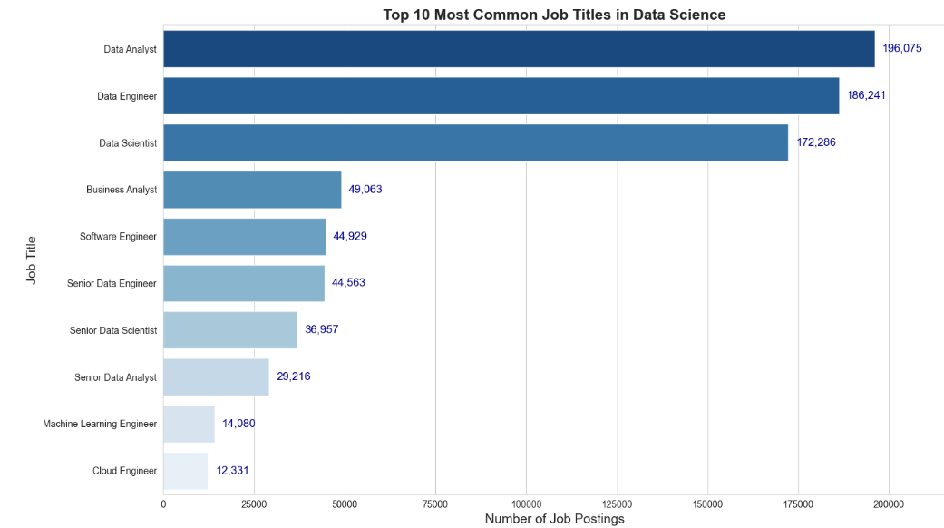
Top 10 Most Common Job Titles in Data Science

Slide 5
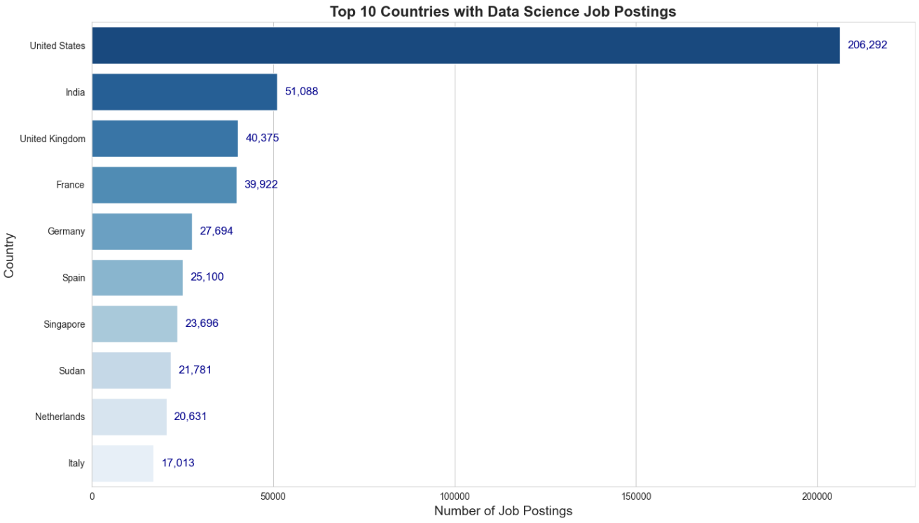
Top 10 Countries with Data Science Job Postings
Leading Countries
Emerging Markets
World map
USA, India, UK dominate job market
Brazil, Singapore show rapid growth

Slide 6
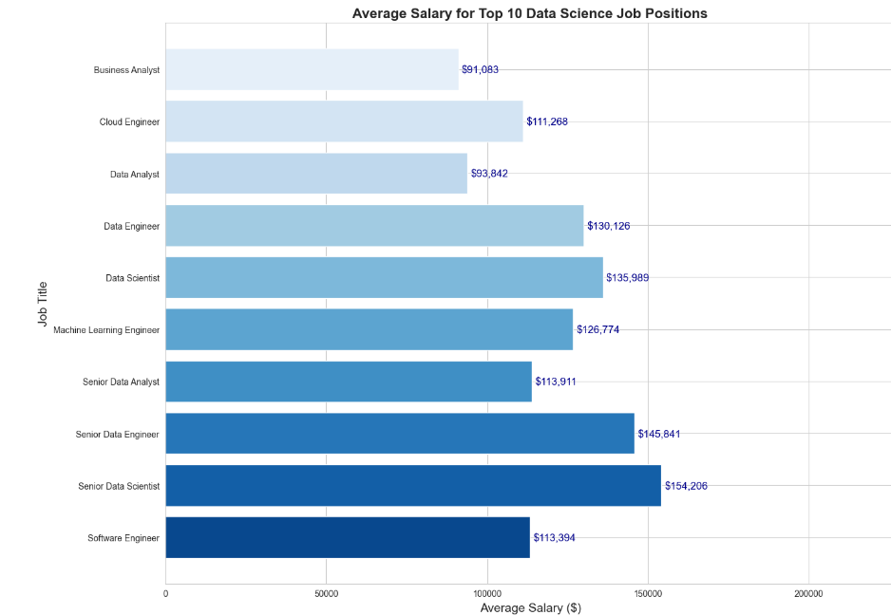
Salary Comparison for Top 10 Data Science Job Positions.

Slide 7

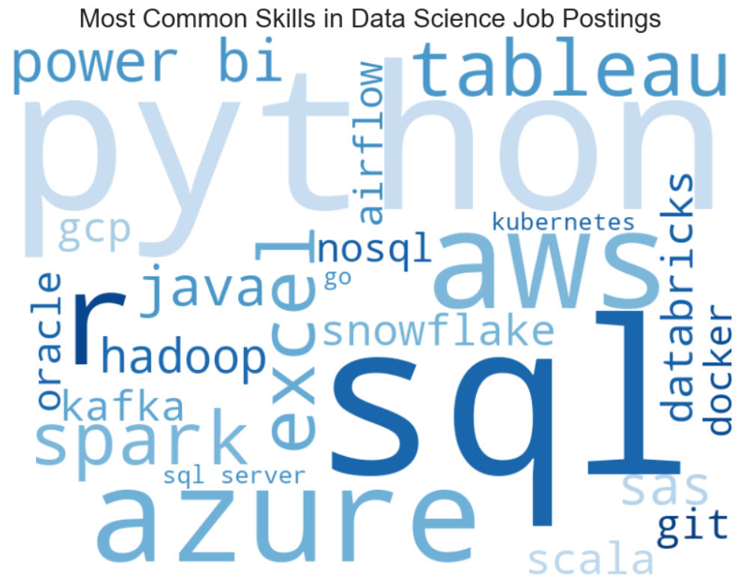
Top 10 Most In-Demand Skills for Data Science

Slide 8

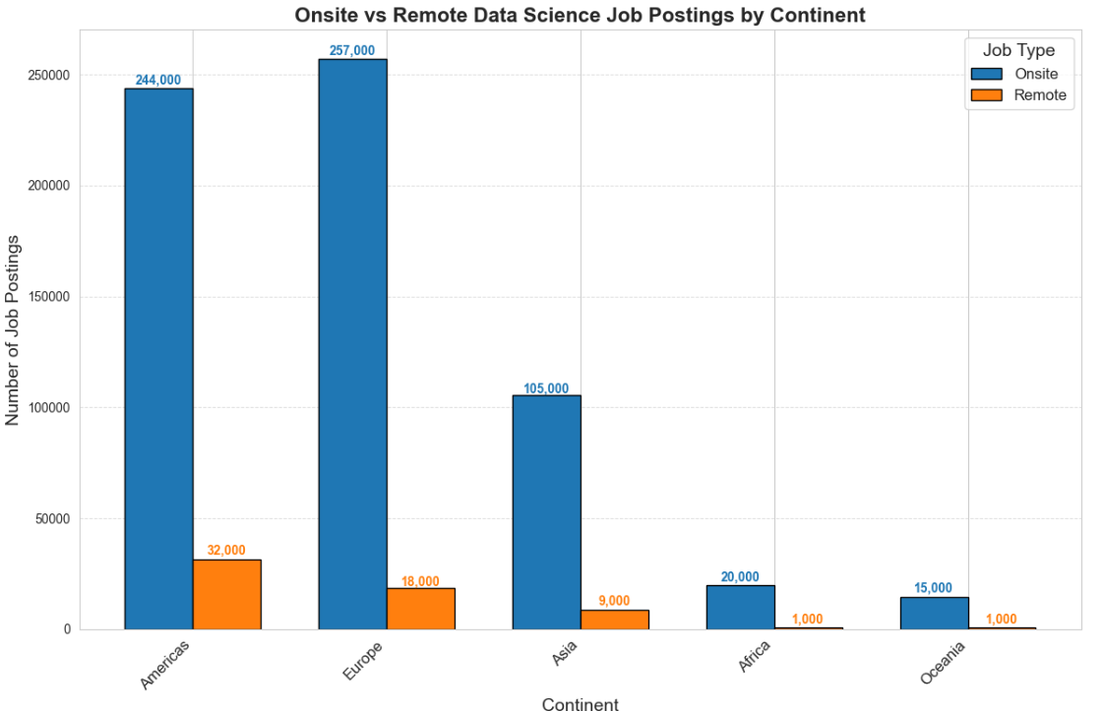
Remote vs Onsite Job Opportunities

Slide 9
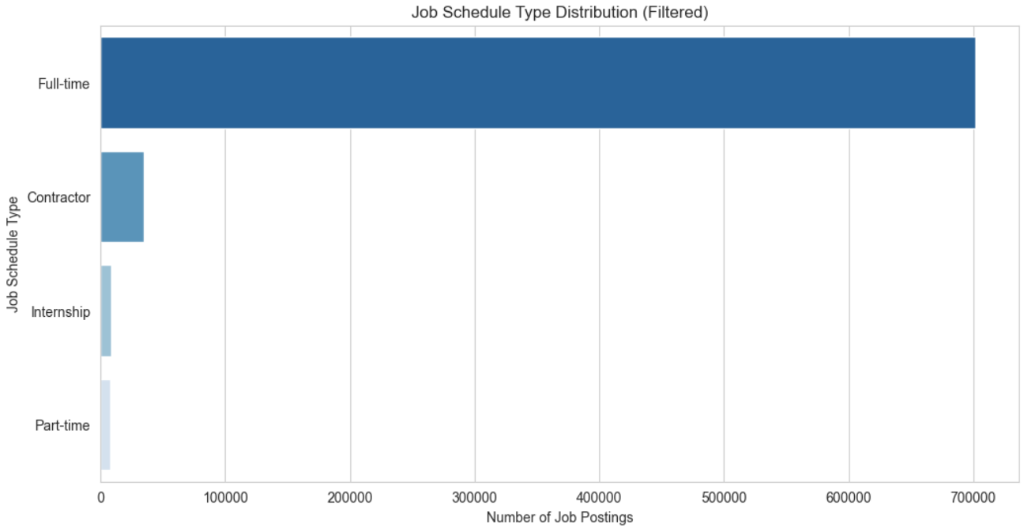
Job Schedule Type Distribution

Slide 10
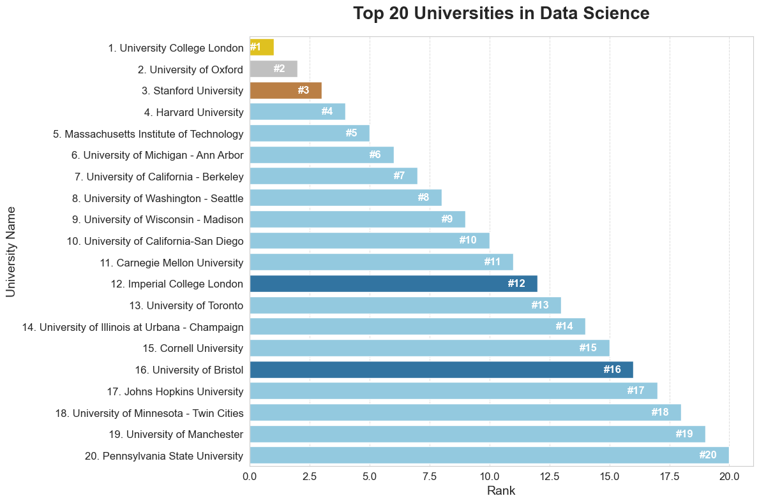
Top 20 Universities for Data Science
Source: EduRank.org

Slide 11
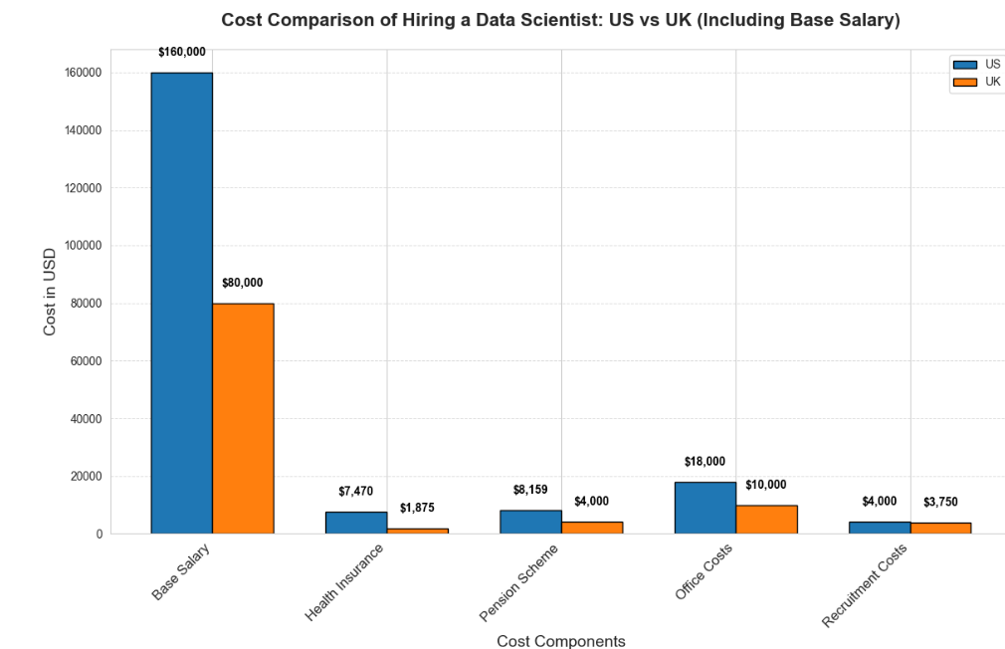
US vs UK: Base Salary & Other Costs

Slide 12
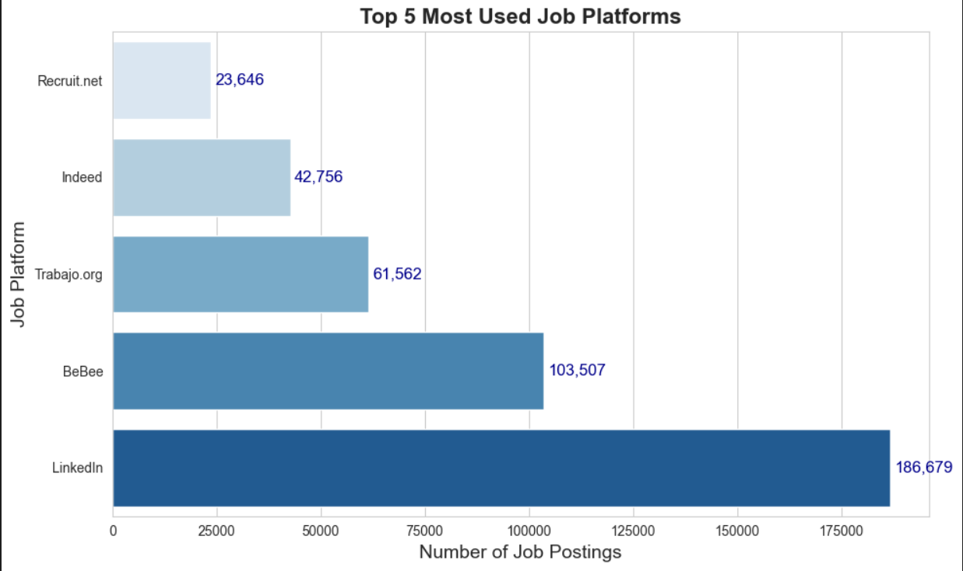
Top Job Platforms for Data Science Job Postings

Slide 13

Top Job Platforms for Data Science
1
LinkedIn
2
Bebee
Focus on personal branding.
Mostly used in Spanish speaking countries
Highest reach for professional networking.
Trabajo.org
4
Indeed
3
Listings and job opportunities for Spanish Speakers
One of the largest and most popular job search platforms

Slide 14




Key Findings
Salary Disparities
UK Cost-Efficiency
Critical Skills
US higher salaries but increased associated costs.
Balanced approach to hiring and benefits.
Python, SQL, Machine Learning in high demand.

Slide 15
Data Science Hiring: UK vs US Market Analysis
UK Advantages
US Landscape
Hiring Strategy
Lower salary expectations for data scientists. Reduced office costs compared to US counterparts.
Competitive market with higher number of top universities. Potentially more experienced talent available.
Consider onsite hiring due to limited remote job postings. UK could offer cost-effective expansion opportunities.
Strong concentration of top universities, indicating high-quality talent pool.
Higher costs associated with salaries and office space.
Evaluate trade-offs between cost savings and access to experienced talent.

Slide 16





Thank You for Your Participation
Q&A Session
Opportunity to address your queries.
Feedback Welcome
Your insights help us improve.
Sincere Appreciation
Your attendance made this event successful.

